Slide 1
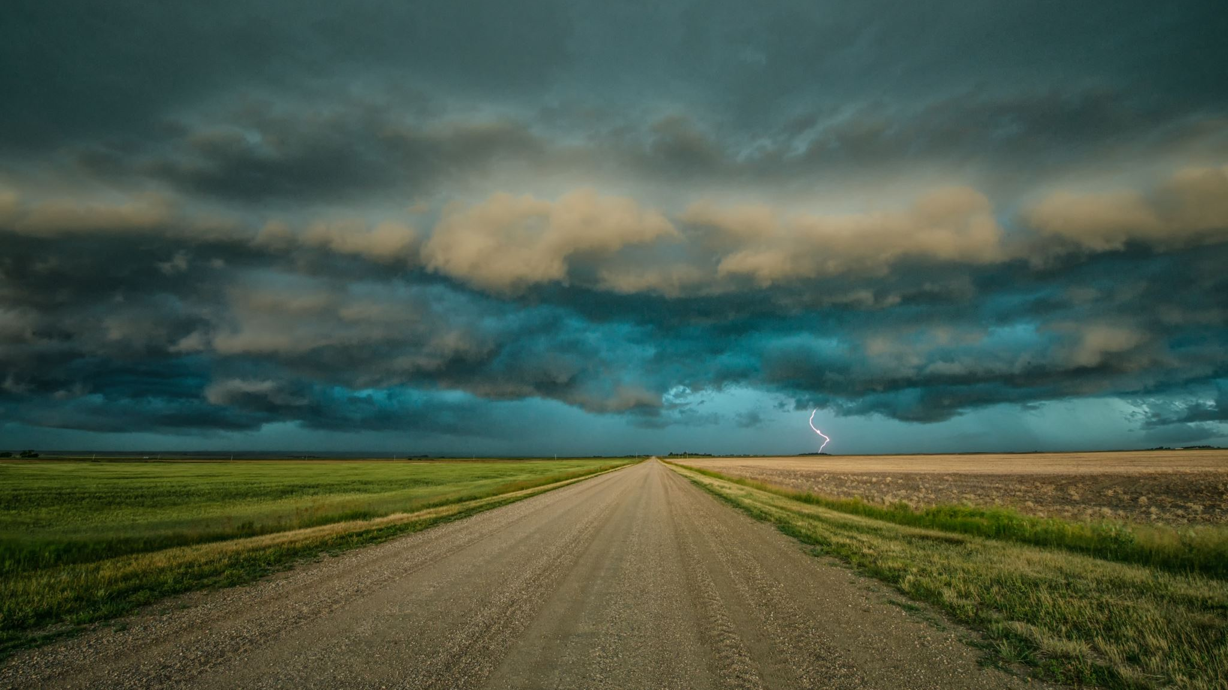
Image Caption Generator
Data Preparation Process

Slide 2
Steps in Data Preparation Process
We have Two steps in Data Preparation Process
Prepare Photo Data
Prepare Text Data

Slide 3
Prepare Photo Data
To interpret the data in the photos we used pre-trained model VGG. The VGG model was provided by the Keras.
The problem is, it is a large model and running each photo through the network every time we want to test a new language model configuration (downstream) is redundant.
Instead, we can pre-compute the “photo features” using the pre-trained model and save them to file. We can then load these features later and feed them into our model as the interpretation of a given photo in the dataset.

Slide 4
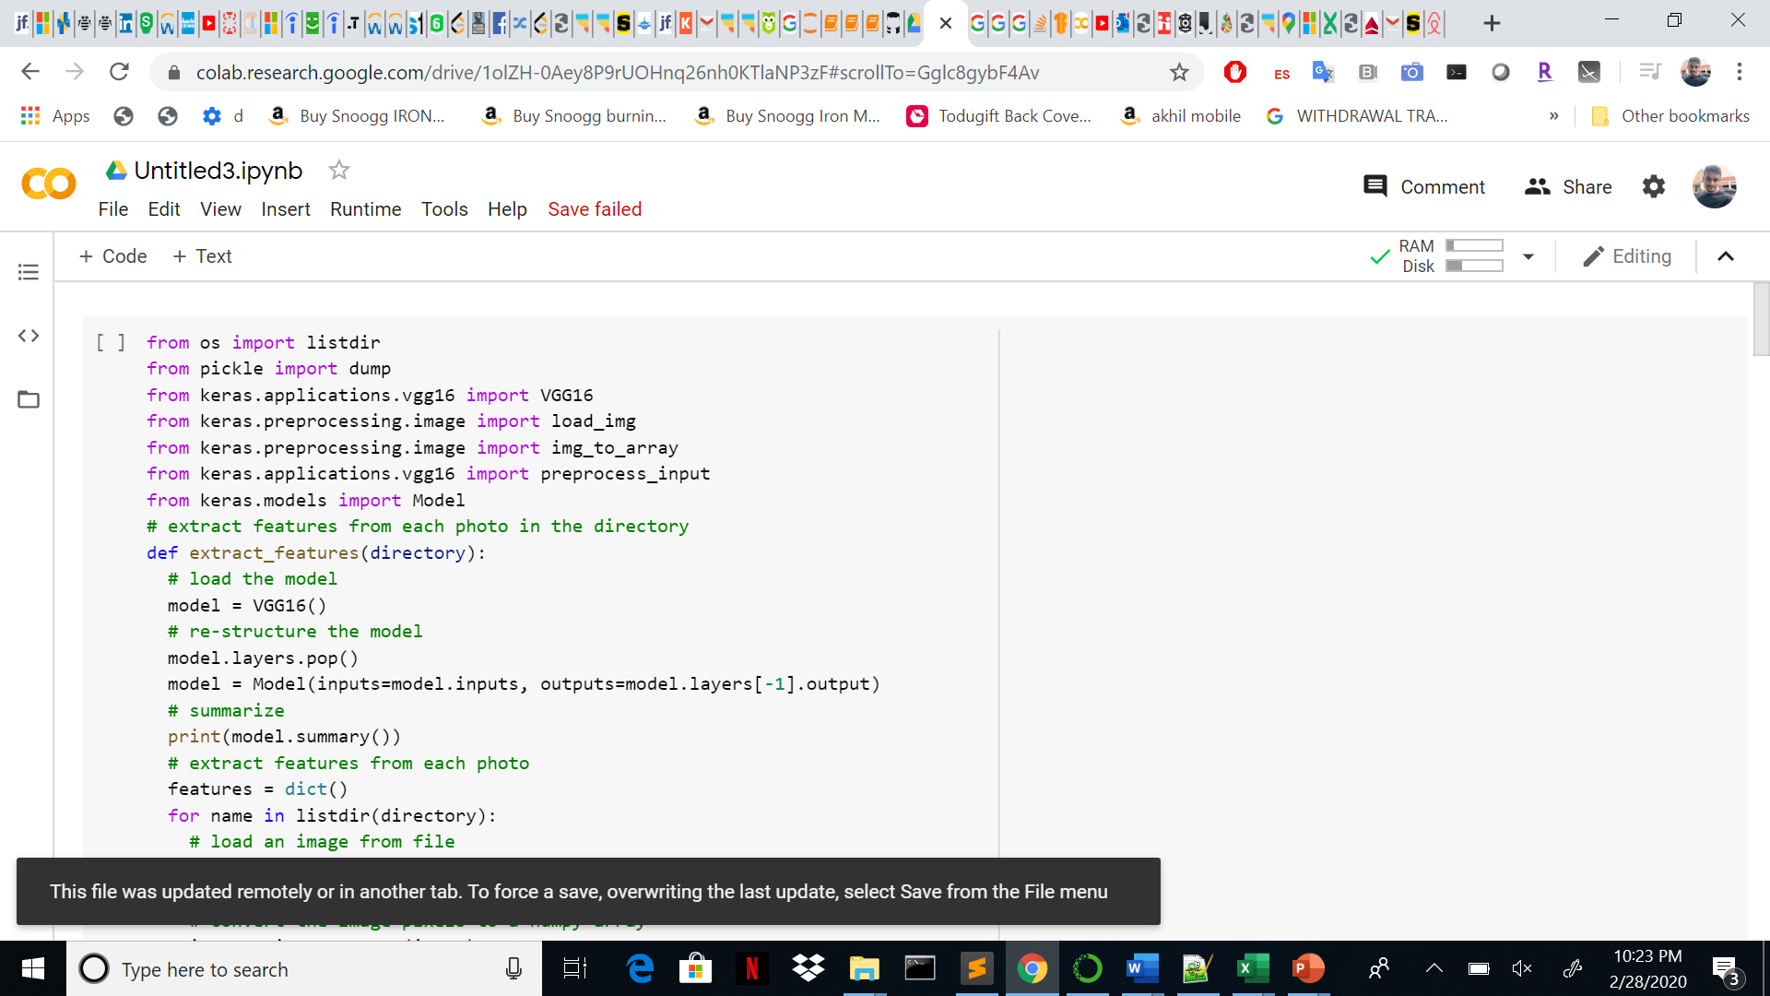
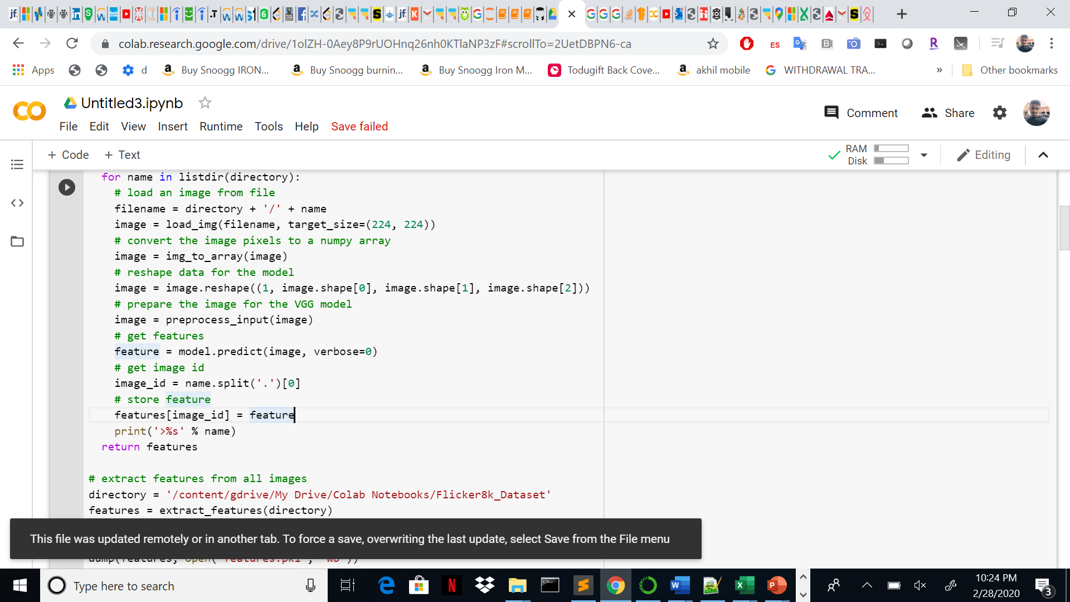
Function for preparing the photo data

Slide 5
PREPARE Text data
The dataset contains multiple descriptions for each photograph and the text of the descriptions requires some minimal cleaning.
Each photo has a unique identifier. This identifier is used on the photo filename and in the text file of descriptions.
Next, we will step through the list of photo descriptions. Below defines a function load_descriptions() that, given the loaded document text, will return a dictionary of photo identifiers to descriptions. Each photo identifier maps to a list of one or more textual descriptions.

Slide 6
Data cleaning process
Next, we need to clean the description text. The descriptions are already tokenized and easy to work with.
We will clean the text in the following ways in order to reduce the size of the vocabulary of words we will need to work with:
Convert all words to lowercase.
Remove all punctuation.
Remove all words that are one character or less in length (e.g. ‘a’).
Remove all words with numbers in them.

Slide 7
Contniuing..
Ideally, we want a vocabulary that is both expressive and as small as possible. A smaller vocabulary will result in a smaller model that will train faster.
For reference, we can transform the clean descriptions into a set and print its size to get an idea of the size of our dataset vocabulary.
Finally, we can save the dictionary of image identifiers and descriptions to a new file named descriptions.txt, with one image identifier and description per line.

Slide 8
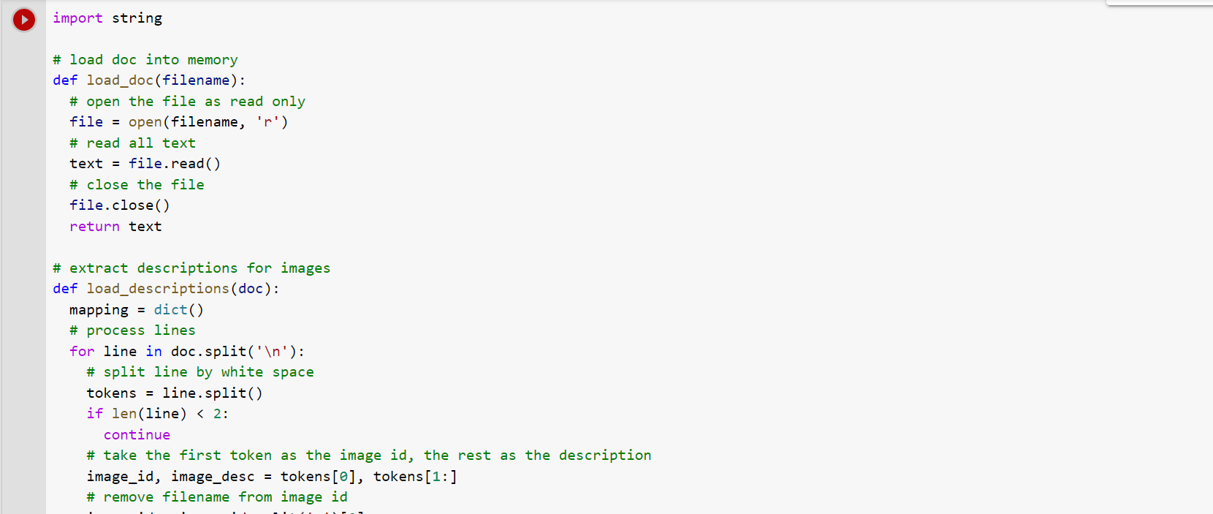
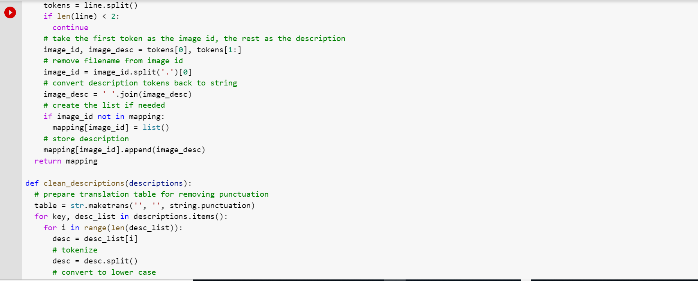
Functions we used in python

Slide 9
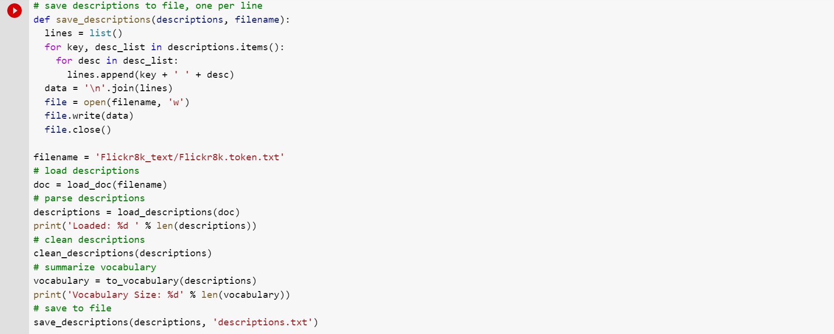
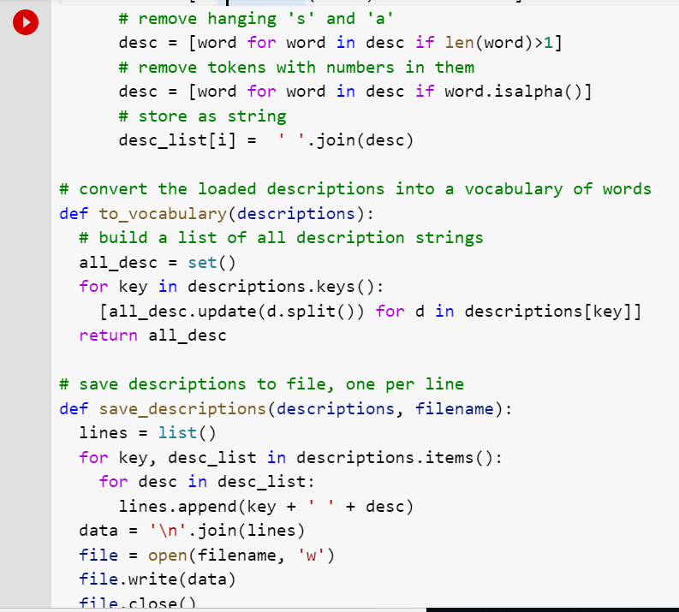
Continuing…

Slide 10
Thank you..
Any questions..?

